Slide 1
AI FOR EVERYONE:
SECOND HALF

Slide 2
WHAT WE HAVE LEARNED SO FAR:
Artificial Intelligence
Machine Learning
Deep Learning
Data Science
Terminologies :
What is ANI and AGI ?
ML technique – Supervised Learning
Workflow of ML and DS projects
What makes an AI company
What ML can do or cannot do

Slide 3
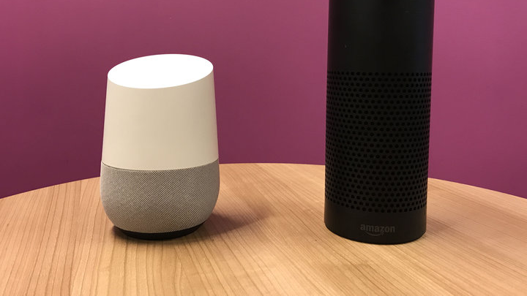
CASE STUDY:
SMART SPEAKER

Slide 4
OBJECTIVE :
What does it feels like to work on a complex AI product.
How you would write AI software to get a smart speaker to respond to
a verbal command such as "Hey device, tell me a joke" and execute on it ?

Slide 5






STEP 1:
Use a Trigger or wake word such as "Hey Device".
The speaker uses a machine learning algorithm to input the audio clip and output 0 or 1 .
AUDIO 0/1

Slide 6
STEP 2: SPEECH RECOGNITION
Now what the software has to do is :
Map the audio clip " Tell me a joke " to a text transcript , which in this case are 4 words .
Audio Tell Me a joke

Slide 7
STEP 3: Intent RECOGNITION
That means to take what have you said and to figure out what you actually wanted to do.
" Tell me a joke " / Music ?
" Do you know something funny " / Alarm ?
" Want to listen a joke " . News ?
JOKE ?
Call ?
Many More ….
Intent mapping

Slide 8

STEP 4 – THE LAST : Execute joke / Command
A classic piece of code written by a software engineer that execute A joke .

Slide 9
AT A GLANCE:
OTHER FUNCTIONS :
KEY STEPS :
PLAY MUSIC
MAKE A CALL
CURRENT TIME
UNIT CONVERSION
GK QUESTIONS
NAVIGATION
TRIGGER WORD DETECTION
SPEECH RECOGNITION
INTENT RECOGNITION
SPECIALIZED PROGRAM TO EXECUTE THE COMMAND

Slide 10

CASE STUDY :
SELF DRIVING CAR

Slide 11
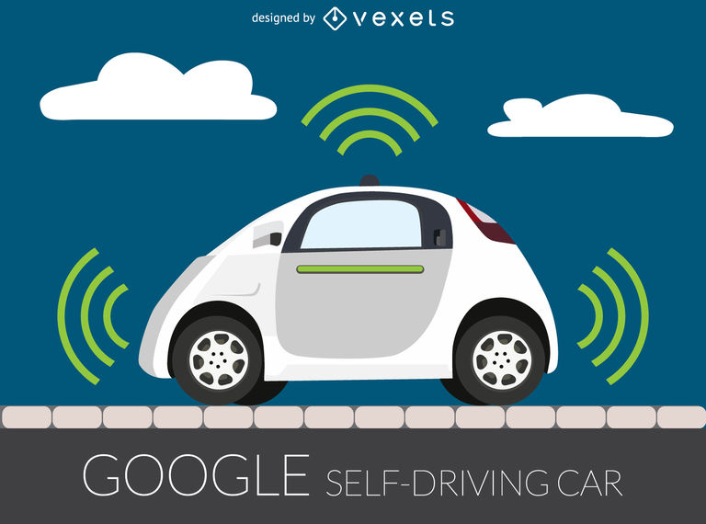
OBJECTIVE :
A simplified description of self-driving car.
Help you to better understand how you can piece together multiple AI components in order to build these amazing things.

Slide 12
BASIC KEY STEPS FOR DECISION :
Car Detection
Pedestrian Detection
Motion Planning

Slide 13
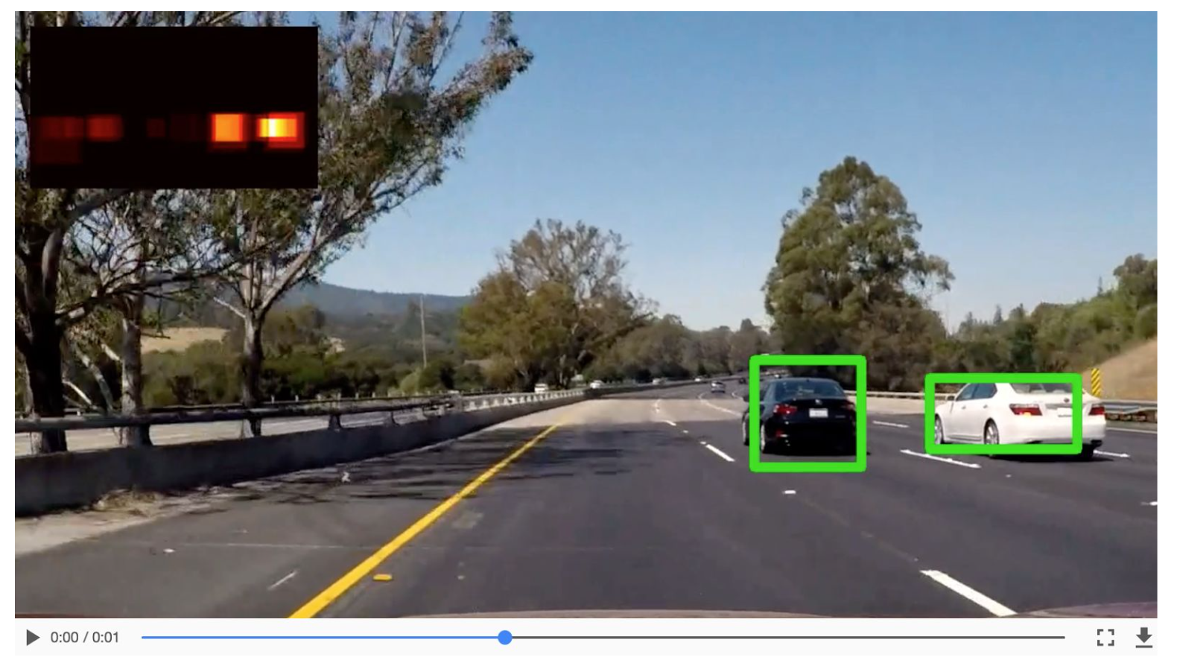
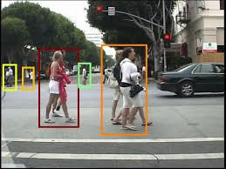
WORKFLOW:
Input Image via
Sensors / camera/radar
Motion planning
Steer/accelerate/brake

Slide 14
SOME OTHER COMPONENTS :
Car Detection
Trajectory Prediction
Input Image via
Sensors / camera/radar
Motion planning
Steer/accelerate/brake
Pedestrian Detection
Trajectory
Prediction
GPS/Maps
Lane Detection
Obstacle Detection
Traffic Light
Detection

Slide 15
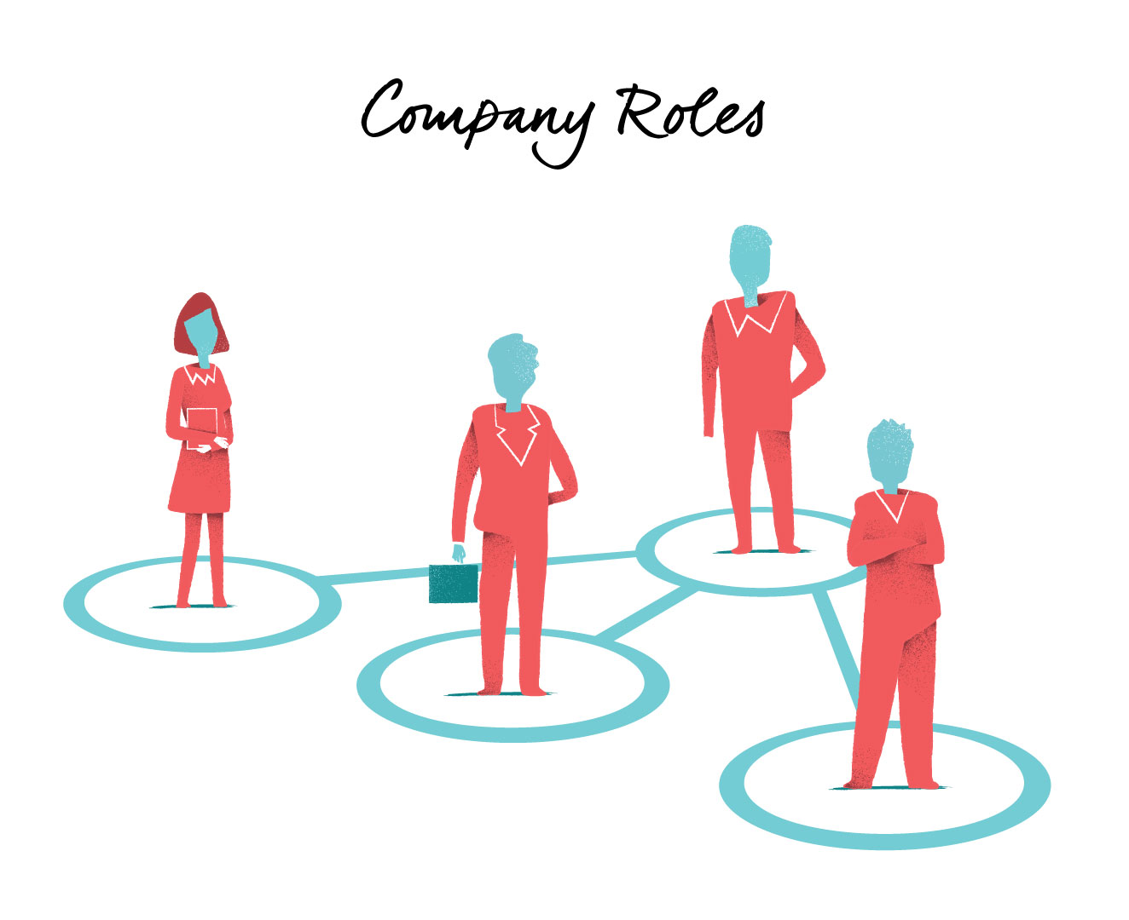
ROLES OF AI TEAM :

Slide 16

Software Engineer
Design Specialized software
Set timer
Telling a weather etc.
ML Engineer
Generating A to B Mapping
Build Algorithm needed for the product
ML Researcher
Extend state-of-art in ML
Some publish papers.
Gather DATA
Focus on doing Research
ML Scientist
State-of-the-art (sometimes cutting edge) refers to the highest level of general development, as of a device, technique, or scientific field achieved at a particular time

Slide 17
Data Scientist
Examine DATA and provide insights
Make Presentations to executive.
Data Engineer
To make sure Data is safe and easily accessible because Data will be in bulk.
AI Product Manager
Helps what to build
Tells what is feasible.
Organize DATA
Tells what is valuable

Slide 18
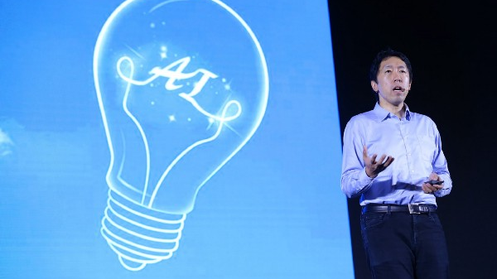
AI TRANFORMATION PLAYBOOK
This Photo by Unknown author is licensed under CC BY.

Slide 19
Review :
Gaining Momentum
Execute pilot project to gain momentum.
AI Team
Build an in-house AI team.
Training
Provide broad AI Training
Strategy
Develop an AI strategy
Communications
Develop internal and external communication

Slide 20

EXECUTE PILOT PROJECT TO GAIN MOMENTUM :
More important for the initial project is to succeed rather than be the most valuable.
Show traction within 6 to 12 months.
First pilot project can be either in-house or out sourced to get expertise and build momentum faster.

Slide 21
BUILD AN IN-HOUSE AI TEAM :
Companies should consider hiring an internal team of AI talents.
This team is responsible for gaining :
AI capabilities
Supporting different divisions with AI solutions
Developing recruiting and retention standards
Building a platform that can be used company-wide .

Slide 22
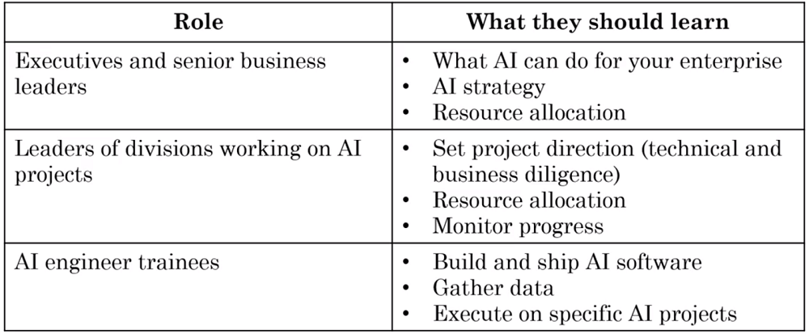
PROVIDE BROAD AI TRAINING :
Employees should be encouraged to receive an AI education via
A combination of in-person consulting and digital courses on AI and machine learning .

Slide 23
DEVELOP AN AI STRATEGY :
Use the virtuous cycle of AI .
Better product leads to more customers , more customer leads to more data and more data leads to better product
This create an industry-specific advantage that you are uniquely positioned to defend against new entrants on the market.
Better Product
More user
More Data

Slide 24

EXAMPLES :
Deploying model to different users results in more data , more training and more accuracy .
1) Smart Speaker – Alexa , Cortana , Siri
2) Facebook – Auto Tagging
3) Online Ad Recommendations

Slide 25
DEVELOP AN INTERNAL AND EXTERNAL COMMUNICATIONS:
Companies should maintain good relationships with investors and governments.
Invest in appropriate marketing
Attract and retain talents.
Promote insightful internal explanations of AI to relieve employee job replacement concerns.

Slide 26

AI PITFALL TO AVOID :

Slide 27
DO
DONT
Be realistic about the limitations of AI .
Include cross functional talent to find feasible and valuable projects .
Go through the iterative process .
Work with the AI team to establish timelines , milestone , KPI etc.
Expect AI can solve everything .
Hire ML Engineers and count solely on them to come up with use cases .
Expect your project to work for the first time.
Expect Traditional planning process to apply without changes.
Think you need a super star AI Engineer .
KPI - key performance indicator is a type of performance measurement. KPIs evaluate the success of an organization or of a particular activity in which it engages.

Slide 28

How to Choose Your First AI Project ?

Slide 29
Get friends TO LEARN ABOUT AI
WHEN YOU GO BIGGER HIRE AI LEADER (VP OF AI /CAIO)
HIRE A FEW ML OR DS PEOPLE TO HELP YOU (COMPANY/IN-HOUSE)
NO PROJECT IS TOO SMALL AND IT'S BETTER TO START SMALL AND SUCCEED, THAN TO START TOO BIG AND NOT SUCCEED
START BRAINSTORMING PROJECT

Slide 30
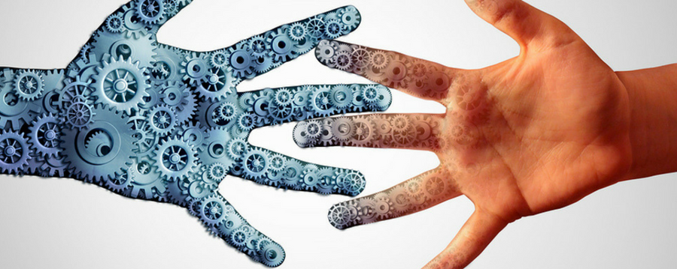
SURVEY OF MAJOR AI APPLICATIONS AREA :

Slide 31

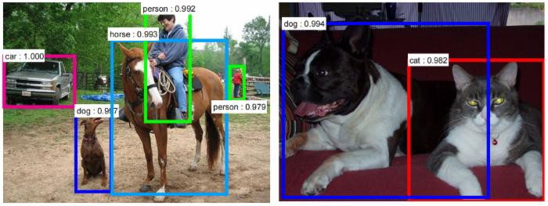
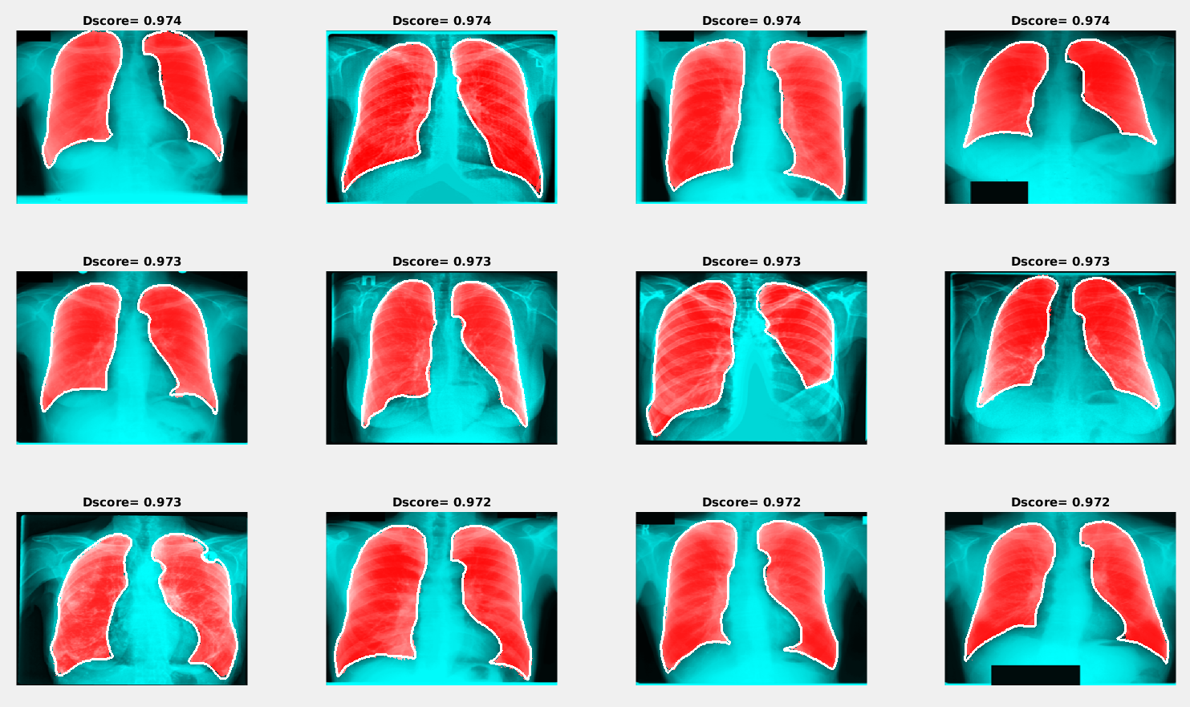
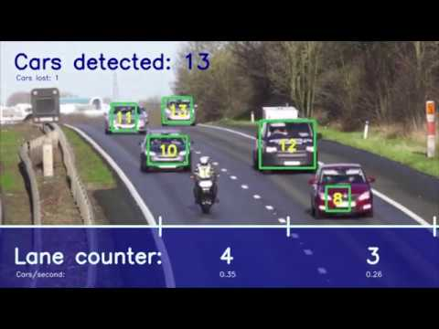
COMPUTER VISION :
IMAGE CLASSIFICATION / OBJECT RECOGNITION -
OBJECT DETECTION -
IMAGE SEGMENTATION -
TRACKING -
Panda

Slide 32
NATURAL LANGAGE PROCESSING :
New Article
Sports
News
Politics
Text Classification -
Information Retrieval – web search
Name Entity Recognition - Pakistan has a friendly relationship with China
Machine Translation - اسلامی جمہوریہ پاكِستان‎ ------ (input)
Islamic Republic of Pakistan ------ (output)

Slide 33
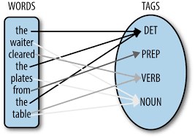
NLP Continue :
Parts of speech tagging

Slide 34
SPEECH :
Speech Recognition – Speech to text
Speaker ID – Predict the speaker
Speech Synthesis – Text to Speech
Wake Word Detection - " Hey Device "

Slide 35
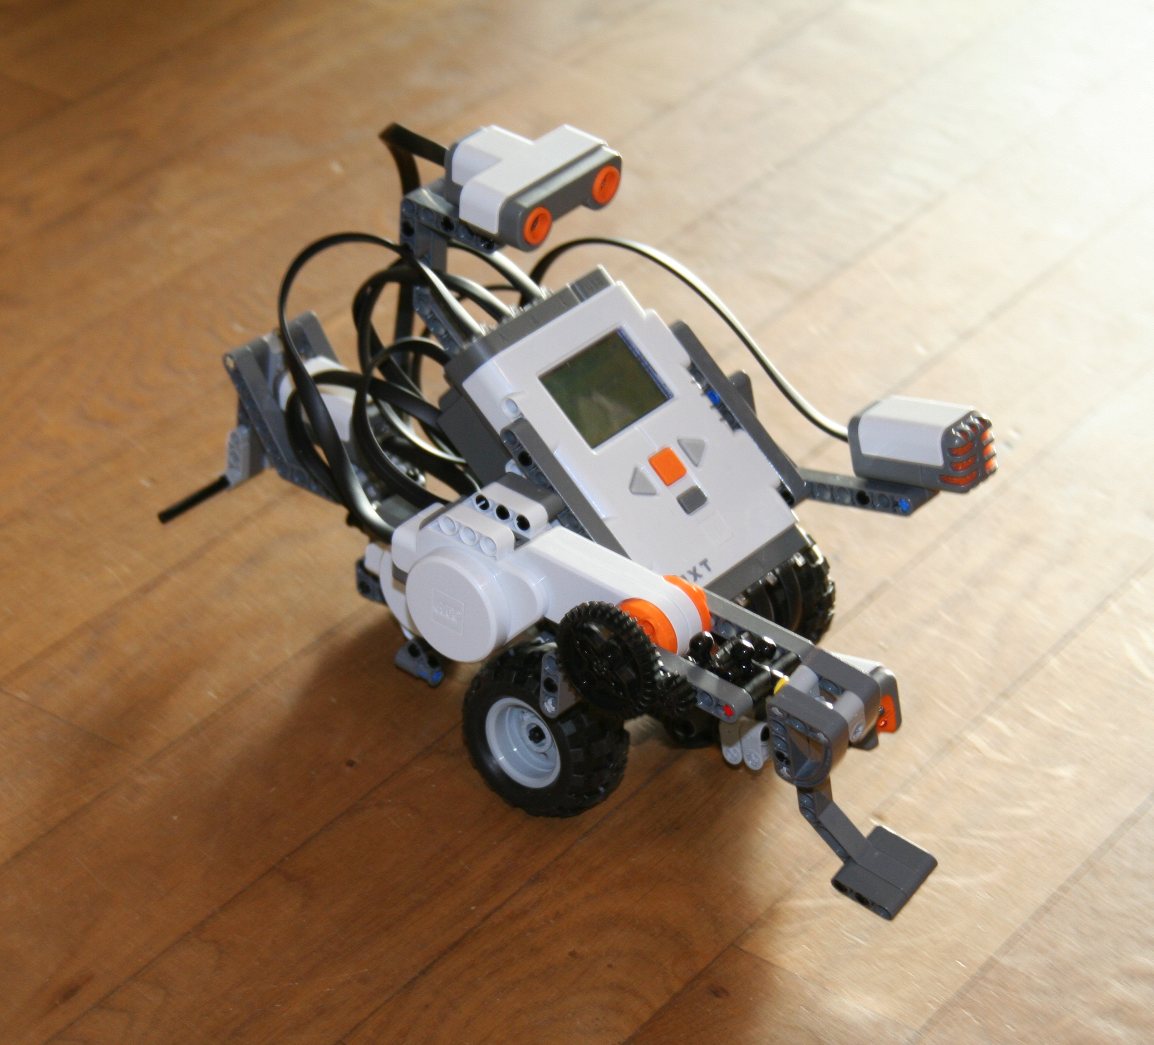
ROBOTICS :
Perception – Figuring out what's in the world around you
Motion Planning – Finding a path for the robot to follow
Control – Sending command to the motors to follow the path

Slide 36
SURVEY OF MAJOR AI TECHNIQUES :

Slide 37
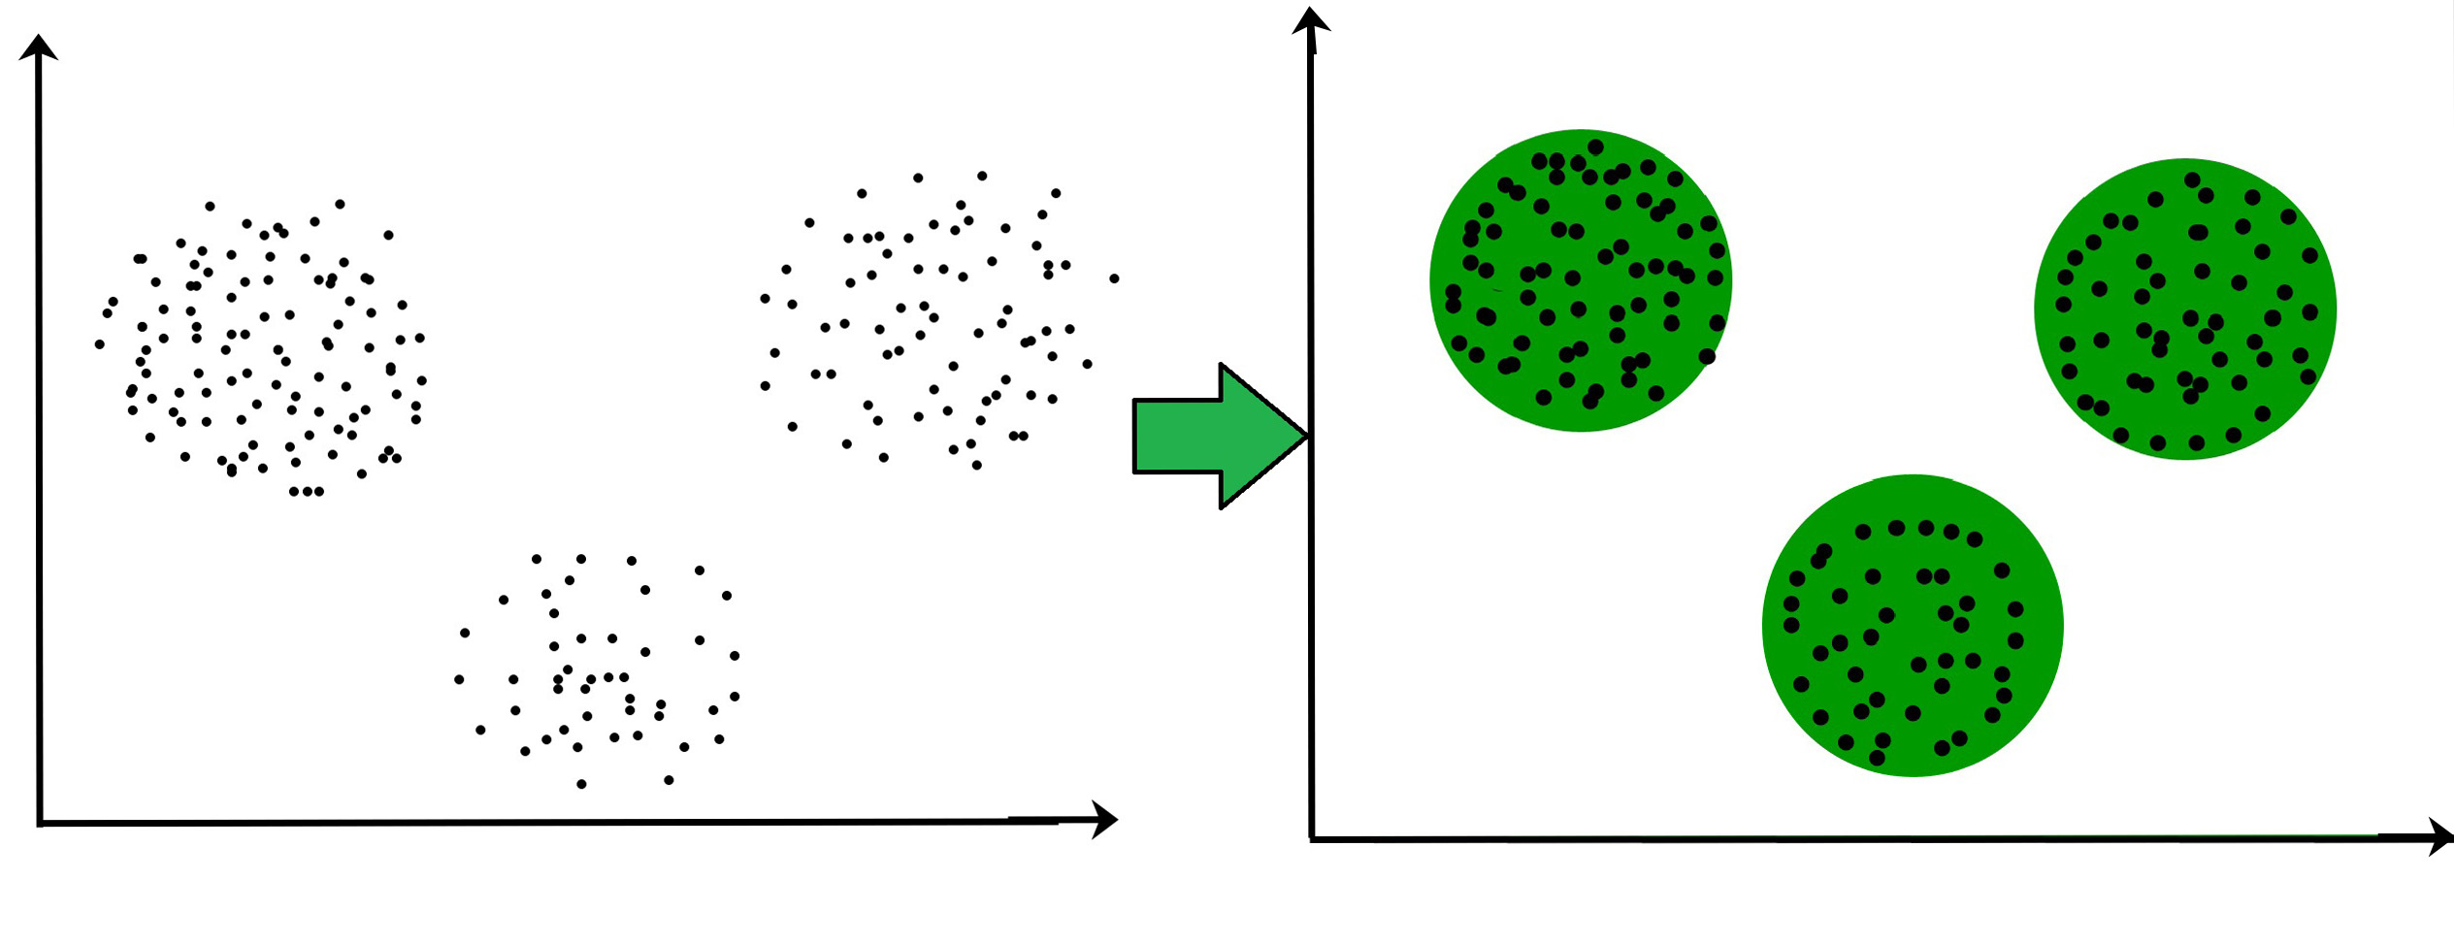
UNSUPERVISED LEARNING :
Unsupervised learning is where the input data is unlabeled and the system tries to learn structure from that data automatically, without any human guidance
Unsupervised Learning Technique – CLUSTERING :
There are 3 clusters or groups in this image

Slide 38
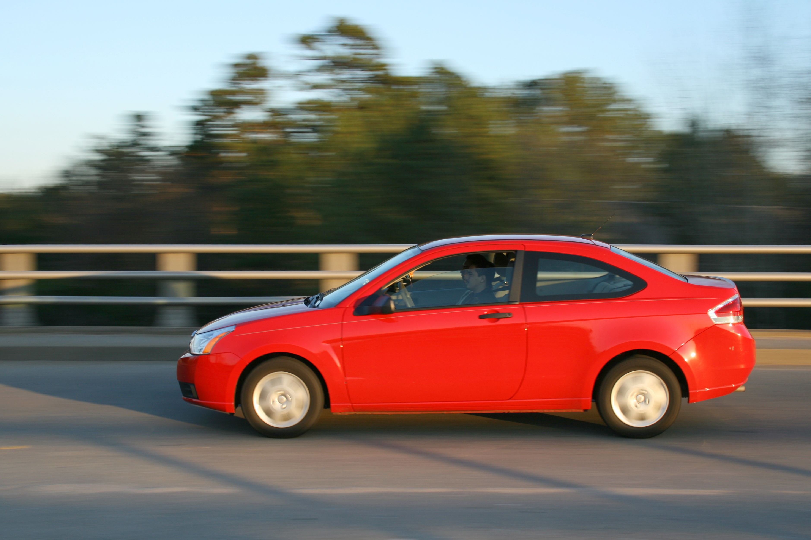
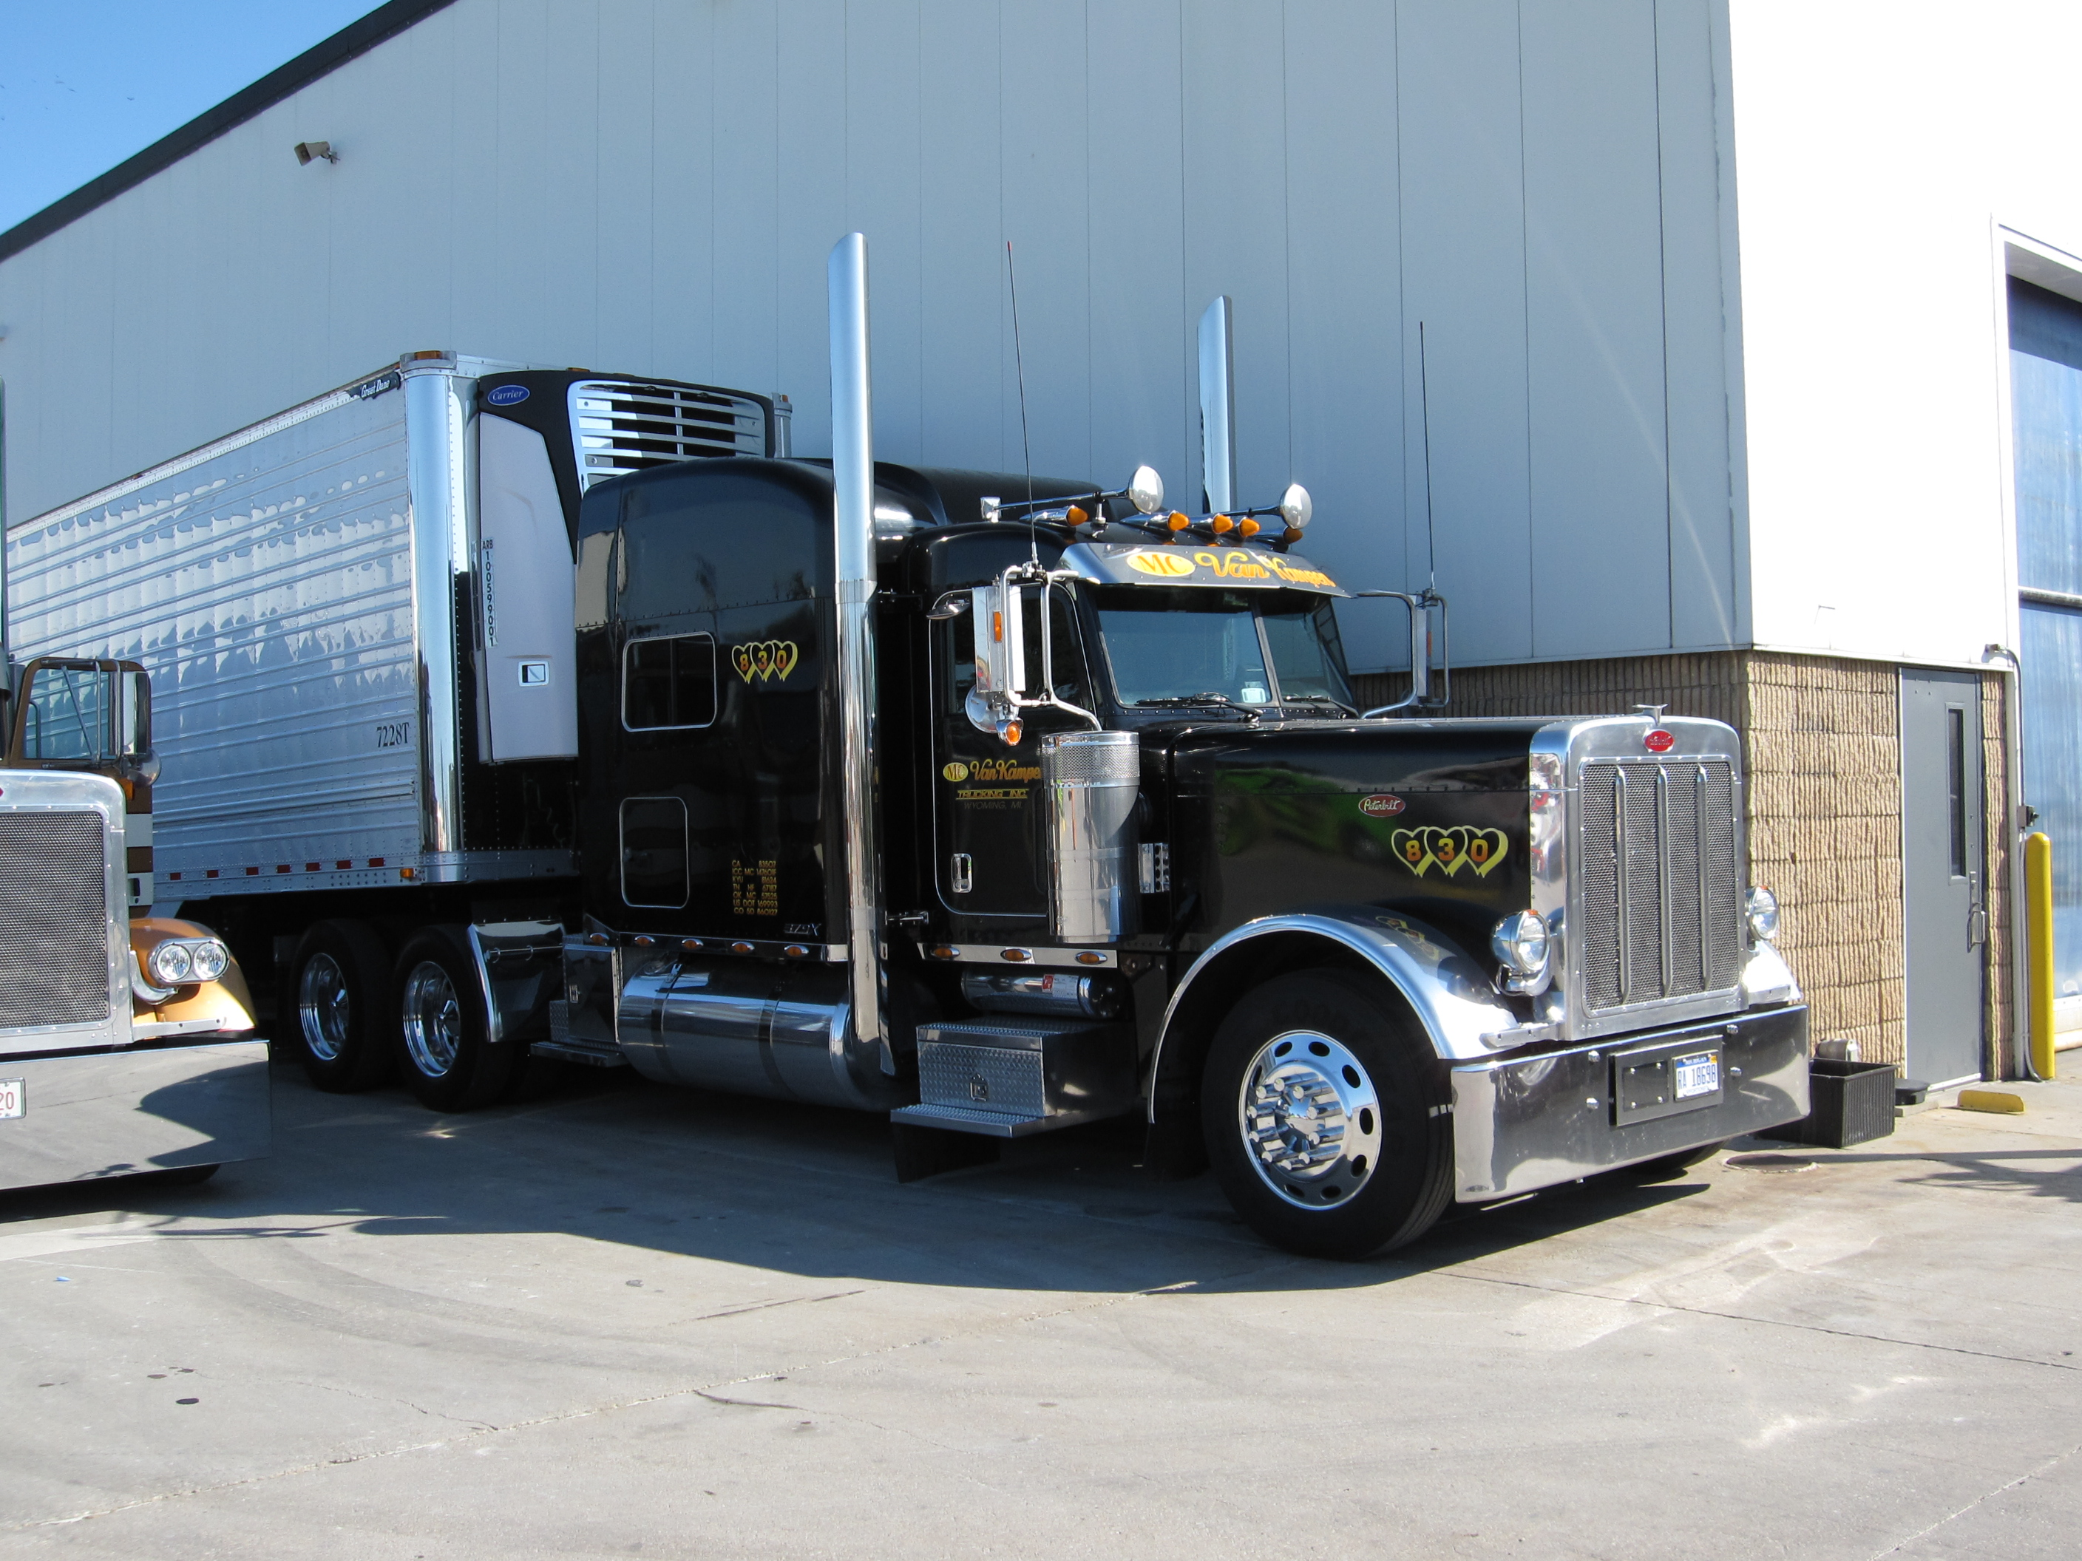
TRANSFER LEARNING :
Transfer learning is a research problem in machine learning that focuses on storing knowledge gained while solving one problem and applying it to a different but related problem .
CAR DETECTION Truck Detection

Slide 39
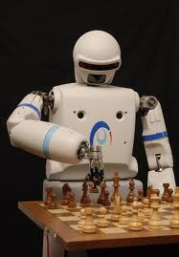
REINFORCEMENT LEARNING :
In reinforcement learning, an agent receives information about its environment and learns to choose actions that will maximize some reward .
Example :
A neural network that looks at a videogame screen and outputs game actions in order to maximize its score can be trained via reinforcement learning.

Slide 40
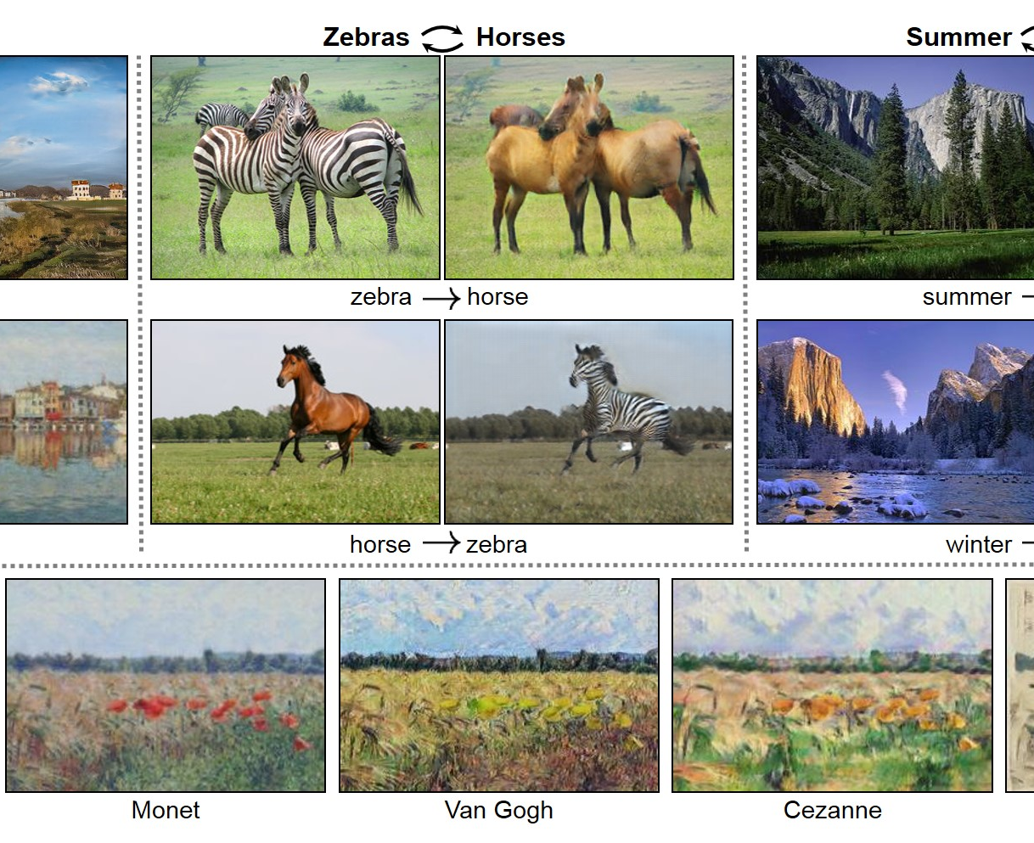
GENERATIVE ADVERSARIAL NETWORK (GAN) :
GAN focuses to generate the data from scratch.
It means GAN is able to produce or to generate new content .

Slide 41
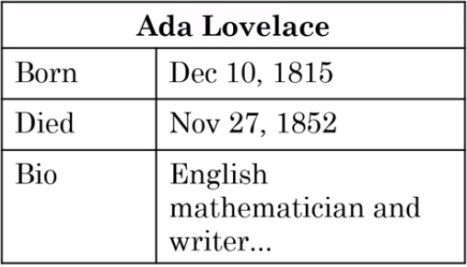
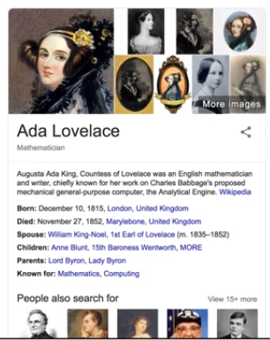
KNOWLEDGE GRAPH :
Information that is drawn from a Knowledge Graph means a database that lists people and key information about these people.
Such as their birthday, when they pass away, their bio, and other properties of these individuals.

Slide 42
AI AND SOCIETY
AI and Hype
Limitations Of AI
Bias
Adversarial Attacks
AI developing Economies and Jobs

Slide 43
A REALISTIC VIEW OF AI
Goldilocks Rule For AI
"Neither Be Too Optimistic Nor Be Too Pessimistic
About What AI Can And Cannot Do"
Too Optimistic : Sentient / super-intelligent AI killer robots coming soon
Too Pessimistic : AI cannot do anything so an AI winter is coming
Just Right : AI can't do everything, but will transform industries

Slide 44

Too Optimistic
we should not be too
optimistic about AI technologies and
having an unrealistic view of AI technologies
may make people think that
sentience or super intelligence,
artificial, general intelligence is coming soon,
and we should invest a lot of resources
into defending against AI evil killer robots.

Slide 45
Too Pessimistic
AI cannot do everything.
There are some things AI cannot do and so, another AI winter is
coming.
AI Winter
The term AI winter refers to a couple of episodes in
history when AI had been over-hyped and when
people figured out that AI couldn't do everything that
they thought it would.
It resulted in a loss of faith and
a decrease in investment in AI.

Slide 46
Just Right
One difference between AI now and the earlier winters of a few decades
ago, is that AI today is creating tremendous economic value.
We also see a surprisingly clear path for it to continue to create even more
value in multiple industries.
So, the combination of these two things ensures that AI will continue
to grow for the foreseeable future.
Even though, it is also true that AI cannot do everything.
Rather than being too optimistic or too pessimistic the story of Goldilocks
learn that something in-between is just right.

Slide 47
LIMITATIONS OF AI
Performance Limitations
Explain ability is hard
Biased AI through biased data
Adversarial attacks on AI

Slide 48

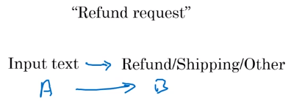
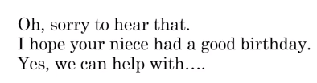
Performance Limitations
"The toy arrived two days late,
so I wasn't able to give it to my niece for her birthday.
Can I return it?"
As we have studied in the previous week about the performance limitations of AI as if you want an AI model to differentiate between the types of emails, it is possible but if you are willing from your AI model to write a proper email in reply of the email you have received it is kind of impossible for now may be soon it will be possible.

Slide 49
Explainability Is Hard
One of the limitations of AI is that
explainability is hard and many high-
performing AI systems are black boxes.
Meaning that it works very well
but the AI doesn't know how
to explain why it does what it does.

Slide 50
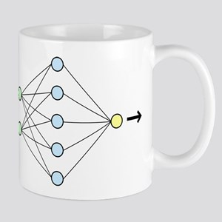
Explainability Is Hard To be fair, humans are also not very good at explaining how we make decisions ourselves.
For Example
How does a human look at this
and say, that's a coffee mug?
You know there are some things
you can point to like, there's a
room for liquid and it has a
handle.
But we humans are not very good at explaining,
how we can look at this and decide what it is.
But because AI is a relatively new thing,
the lack of explainability is
sometimes a barrier to its acceptance.

Slide 51
Biased AI through biased data
As a society, we do not want to discriminate against individuals based on their gender, based on their ethnicity and we want people to be treated fairly. But when AI systems are fed data that doesn't reflect these values, then an AI can become bias or can learn to discriminate against certain People.AI systems are already making important decisions today, and will continue to do so in the future as well. So, bias matters.

Slide 52
Biased AI through biased data
For Example :
If an AI system is trained primarily on data of lighter skin individuals, then it will be more accurate for that category of individuals to the extent that these systems are used in, for example, criminal investigations, this can create a very biased and unfair effect or dark-skinned individuals

Slide 53
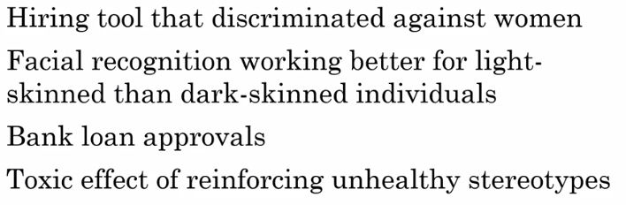
Why Bias Matters

Slide 54
How To Reduce Bias
Techincal Solutions
Zero out the bias in words
Use less biased and/or more inclusive data
Transparency And/Or Auditing Processes
Diverse Workforce
constantly check what types of bias, if any, these AI systems are exhibiting
the organizations are becoming more heterogeneous mix of people in terms of gender,age,ethnicity etc

Slide 55
Technical Solutions
Zero out the bias in words
Use less biased and/or more inclusive data
Researchers have found that when
an AI system learns a lot of
different numbers with which to store
words, there are few numbers that
correspond to the bias.
If you zero out those numbers,
just set them to zero,
then the bias diminishes
Significantly.
Try to use less bias and or more
inclusive data.
For example, if you are building a
face-recognition system, and make
sure to include data from multiple
ethnicities, and all genders, then
your system will be less biased and
more inclusive.

Slide 56
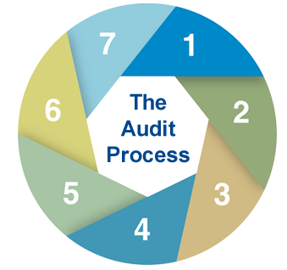
Transparency And/Or Auditing Processes
Many AI teams are subjecting their systems to better transparency and or
auditing processes, so that we can constantly check what types of bias, if
any, these AI systems are exhibiting, so that we can at least recognize the
problem if it exists, and then take steps to address it.
For example, many face recognition teams are systematically checking
how accurate their system is on different subsets of the population to
check whether, it is more or less accurate on dark-skinned versus light-
skinned individuals. Having transparent systems as well as systematic auditing processes increases the odds that will at least quickly spot a problem, in case there is one, so that we can fix it

Slide 57

Adversarial Attacks On AI
Picture Perturbation
Physical Attacks

Slide 58

Picture Perturbation
Picture Perturbation means to make minor changes in the pixels of the image, the changes that are almost imperceptible to the human eye.
But an AI system sees the world very differently
than you and I do.

Slide 59

Physical Attacks
Physical Attacks means to add some extra content in a picture which can fool the AI system
For Example :
A different group of researchers showed that if you affects stickers like these onto a stop sign, you can fool an AI system into not seeing the stop sign at all. It things there's something else there other than a stop sign.

Slide 60

Physical Attacks
A group at Carnegie Mellon University
was able to design a funky pair of glasses like this.
So, that when does man wears this pair of glasses,
he can fool an AI system into
thinking that he is actress Milla Jovovich.

Slide 61

Adversarial Defenses
Defenses do exist, but incur some cost
Similar to spam vs anti-spam, we may be in an arms race for some applications

Slide 62
Adverse Uses Of AI
Deep Fakes
Synthesize video of people doing things they never did
Undermining of democracy and privacy
Oppressive Surveillance
Generating fake comments
Spam vs Anti-Spam and Fraud vs Anti-Fraud

Slide 63

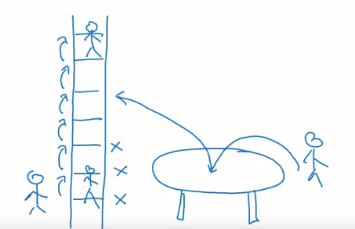
AI and Developing Economies
Leap Frog
Leapfrogging is the notion that areas which have poorly-developed technology or economic bases can move themselves forward rapidly through the adoption of modern systems without going through intermediary steps.

Slide 64
Leap Frog
Examples
Mobile Phones
Developing Countries switched directly on mobile phones instead of landlines which were used by developed countries.
Online Education
Developing Countries which do not have much universities and institutes for higher education have directly switched for online education.

Slide 65
How Developing Economies Can Build AI
Focus on AI to strengthen a country's vertical industries
Developing countries today should not try to build their own
Web search engine. There are already great web search engines
and that was last decades competition.
Instead, if a country has a very strong vertical industry then that
country should build AI to automate that industry, it will even further
Strengthen that industry.

Slide 66
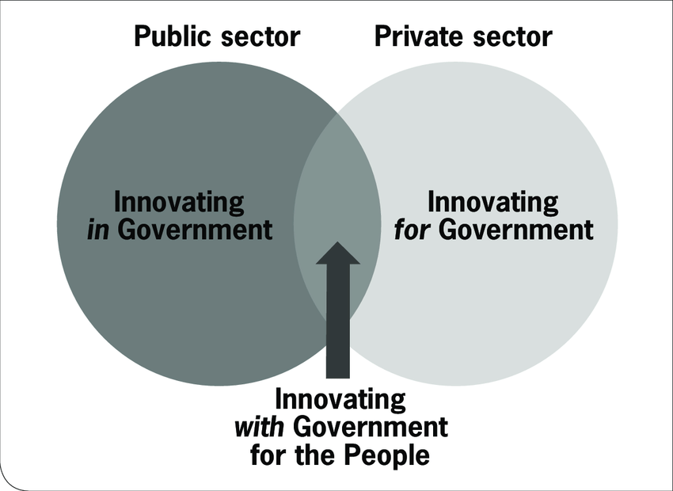
How Developing Economies Can Build AI
Public Private Partnerships To Accelerate Development
Public-private partnerships, meaning governments and
corporations working together, can really help accelerate a
vertical industry's AI developments.
In highly regulated sectors, ranging from healthcare
to transportation like self-driving cars to finance, there are
certain outcomes that we want and certain outcomes that
we don't want.

Slide 67

How Developing Economies Can Build AI
Invest In Education
AI is still so immature. There's still plenty of room for every nation
to learn more about AI, maybe even build up its own AI
workforce and participate in a significant way in this AI
powered world that we're building.

Slide 68
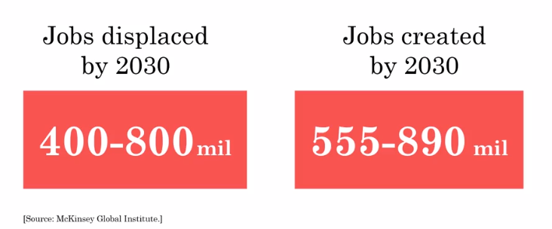
AI Impact On Jobs World Wide

Slide 69
Conclusion :
What you have learned ?
What is AI ?
Building AI Projects
Building AI in your company
AI and Society
Best Of Luck For Your Test !

